Slide 1
Java Text Editor
By 19SW42

Slide 2
Identification of problem Where data structuring is necessary
I wanted to make a text editor using java using which we can open, modify or create new text files. So to record the information about which file is opened or what modifications have been done with a file, I needed a data structure in which I can store this kind of information.

Slide 3
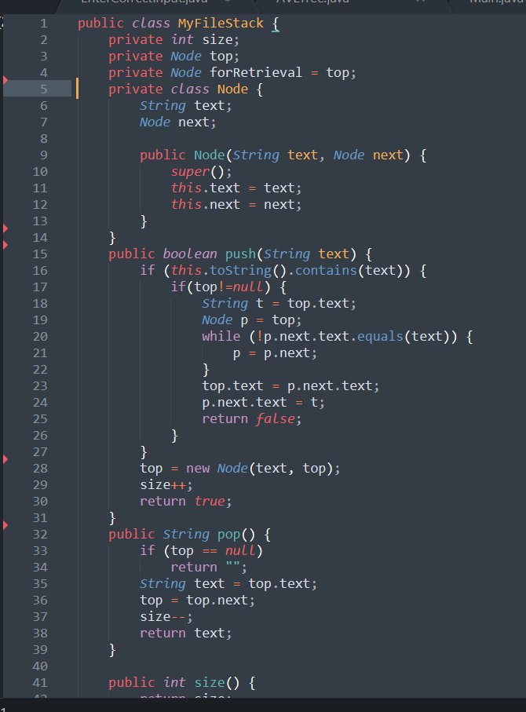
Proper use of data structure
As the text editor I am going to make has operation like undo/redo or open from history(the file(s) opened before opening of current file) options so this is clear that no data structure other than Stack could achieve this goal in an efficient manner.
As from stack we can undo very easily by popping recent activity and same goes for redo and open from history options. For that I have provided my own implementation of stacks.

Slide 4
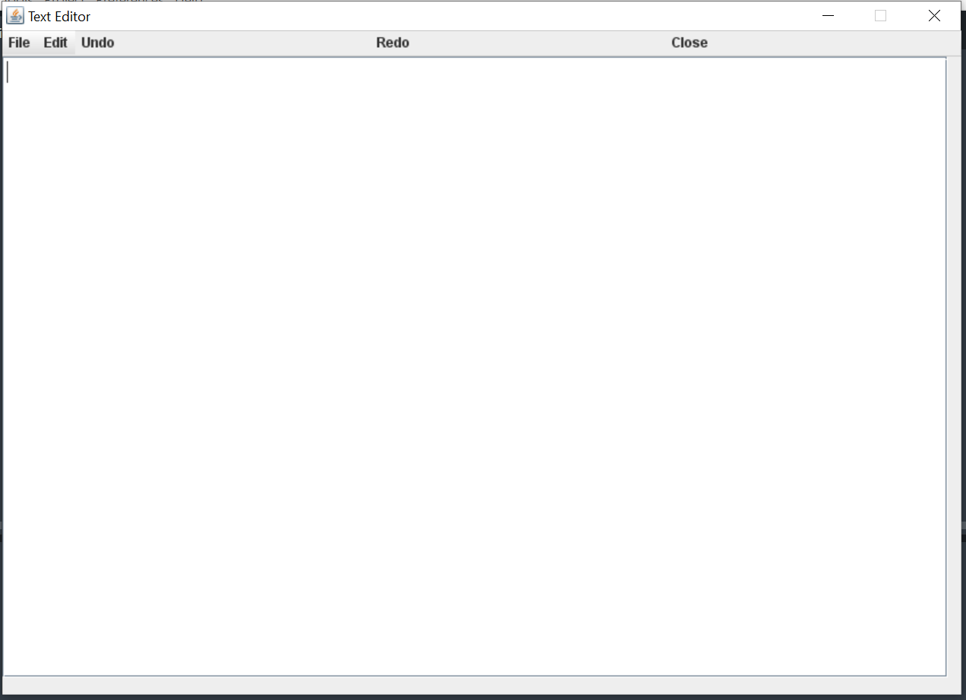
Originality of project
Though it has some basic functionalities to interact with text files but we can say that some how it works same as the notepad which opens/edits/creates text files. This his how my text editor looks like

Slide 5
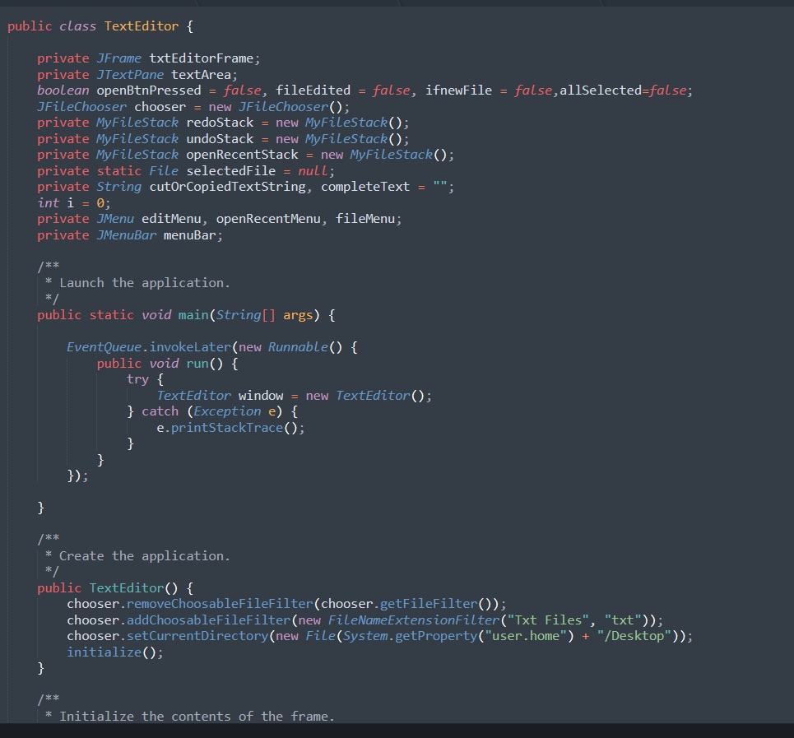
Adequacy of the solution provided
The outcome of this project is a working text editor as it was expected to be. It works as it should do.

Slide 6
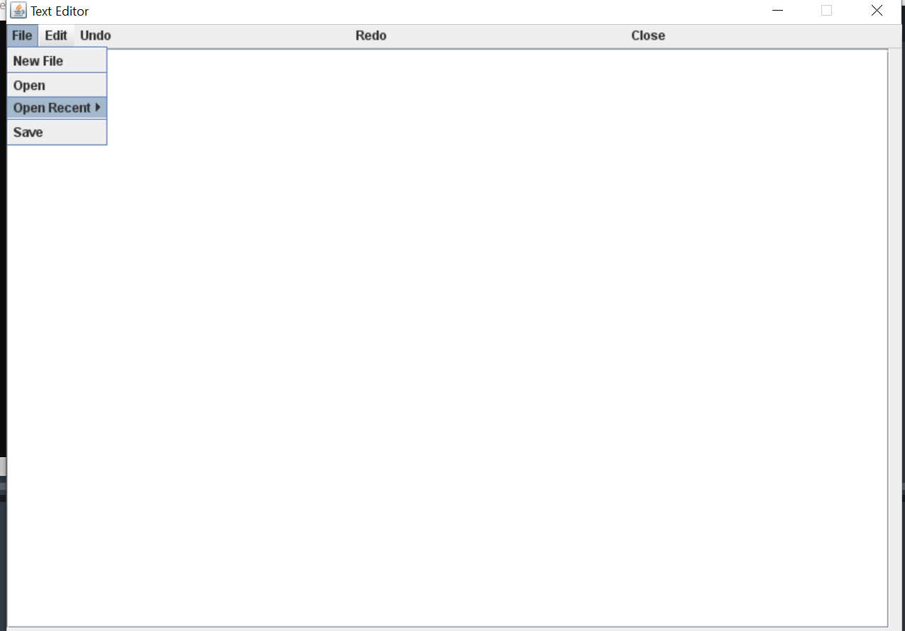
Completeness of project
All functionalities that were thought to be part of this project i.e text editor. are fulfilled very well. Each operation is performing actions as it should do which includes cut, copy, paste, clear, new file ,save file, undo redo and closing operations.

Slide 7
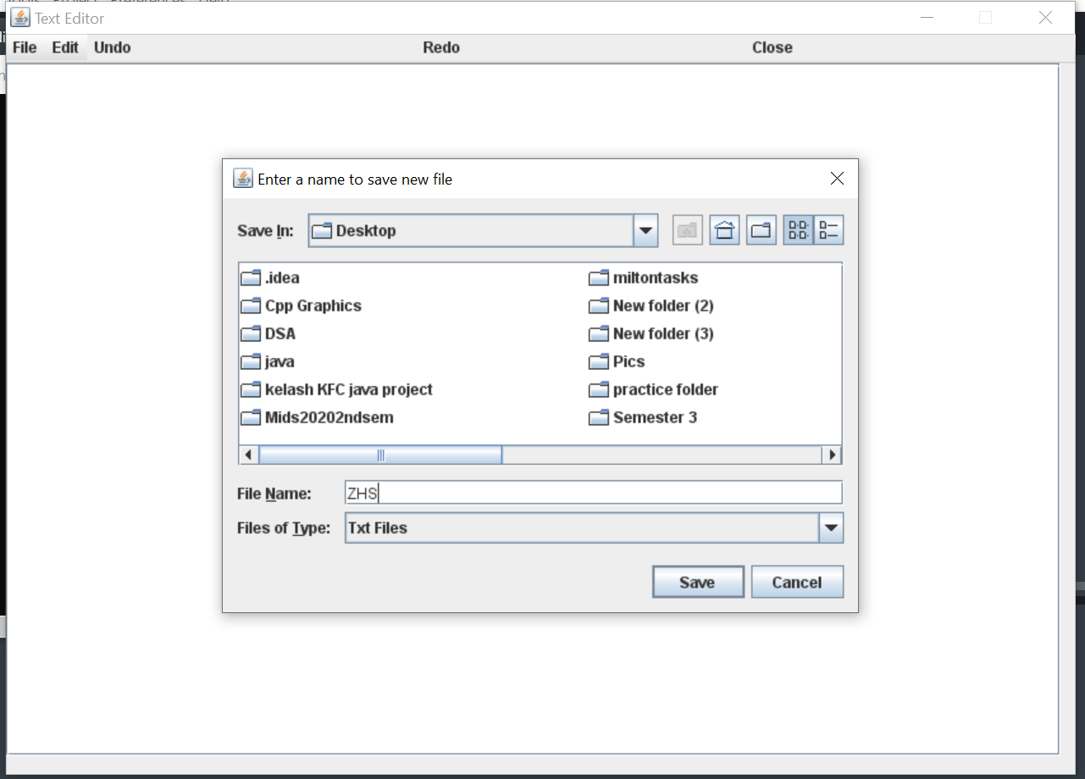
New File

Slide 8
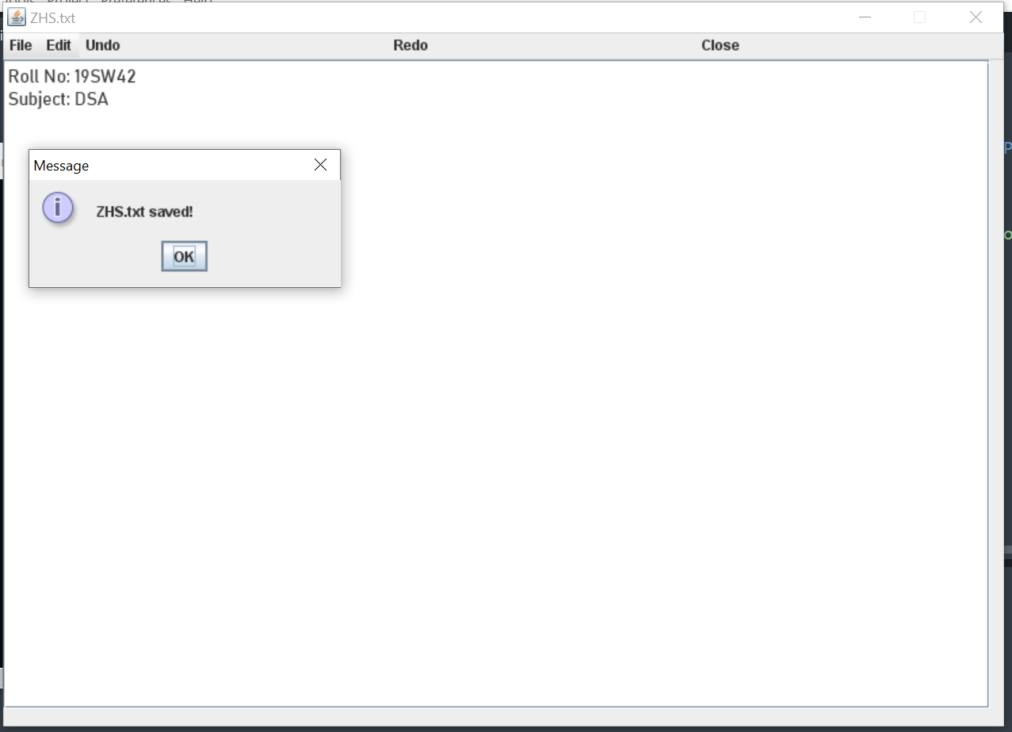
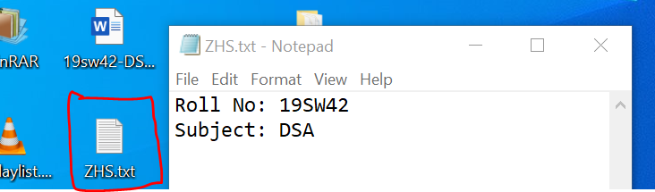
Save(saving file after writing some content)

Slide 9
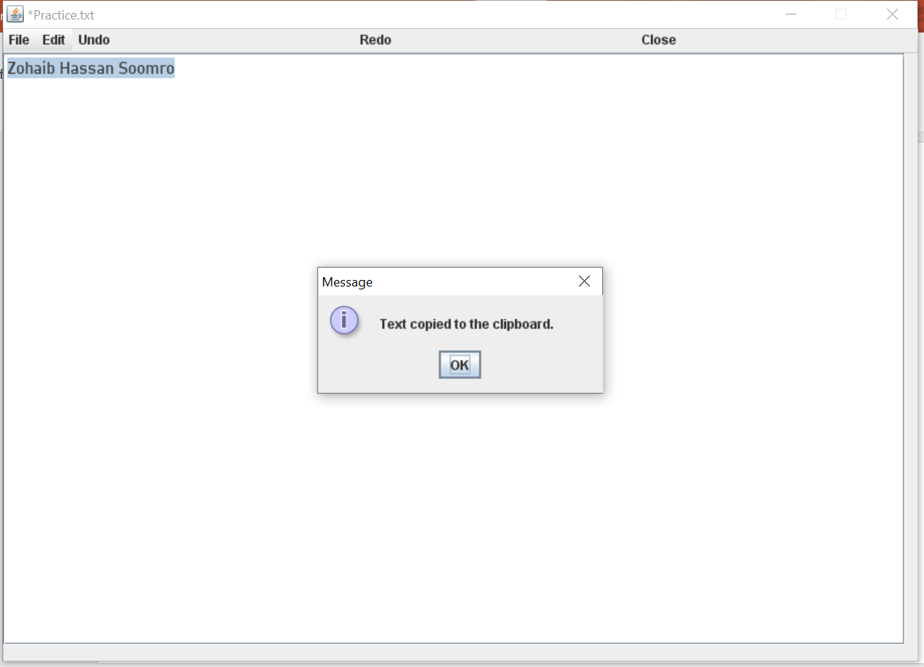
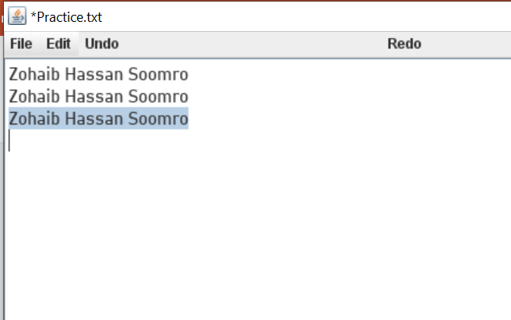
Copy/paste

Slide 10
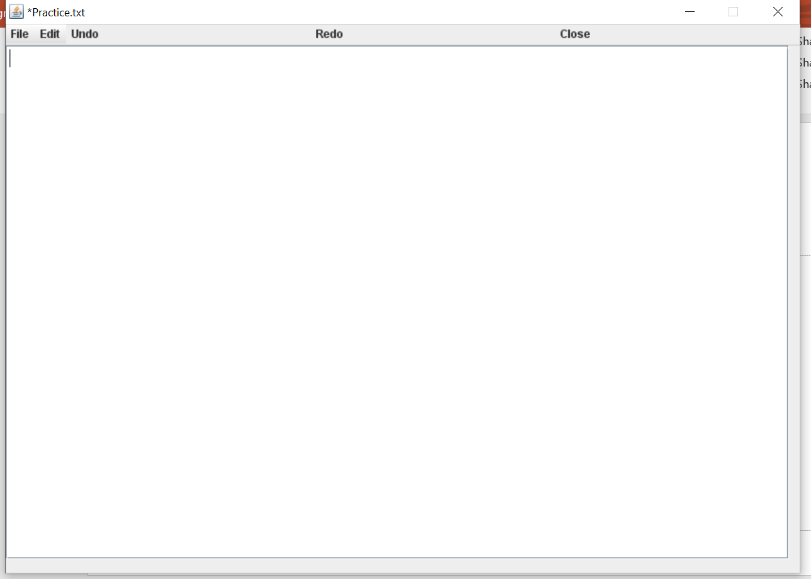
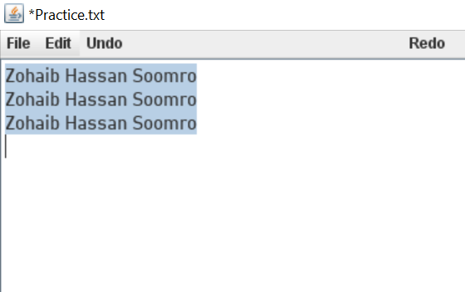
Cut/paste

Slide 11
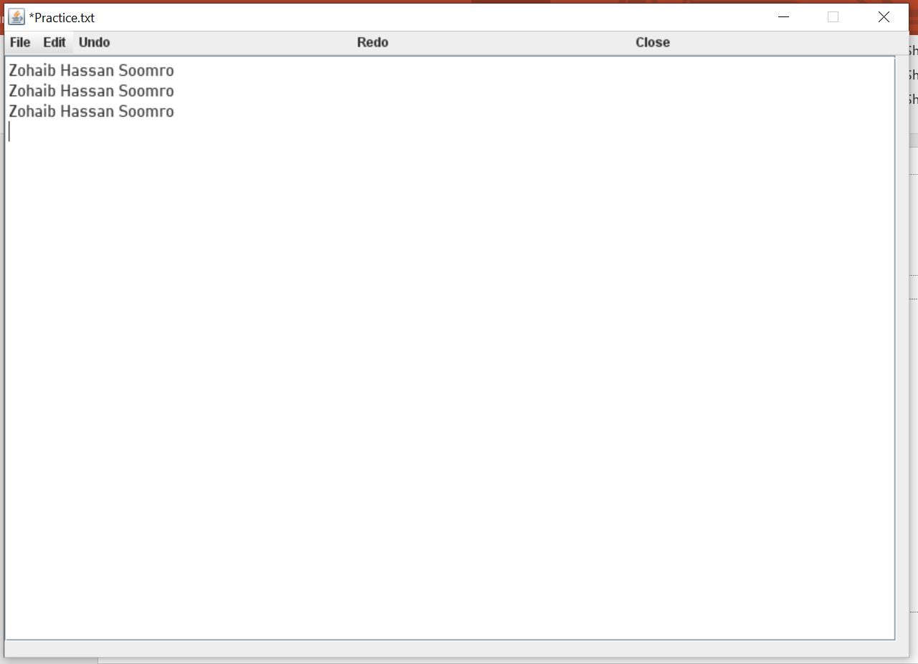
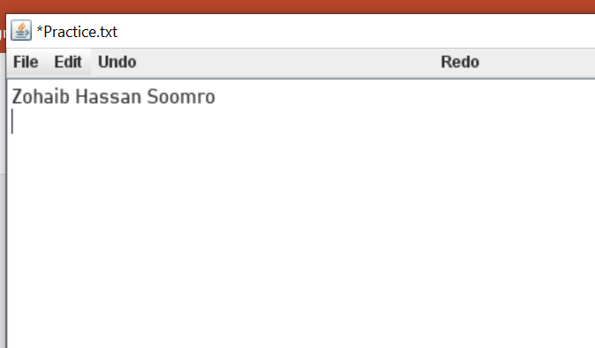
Undo

Slide 12
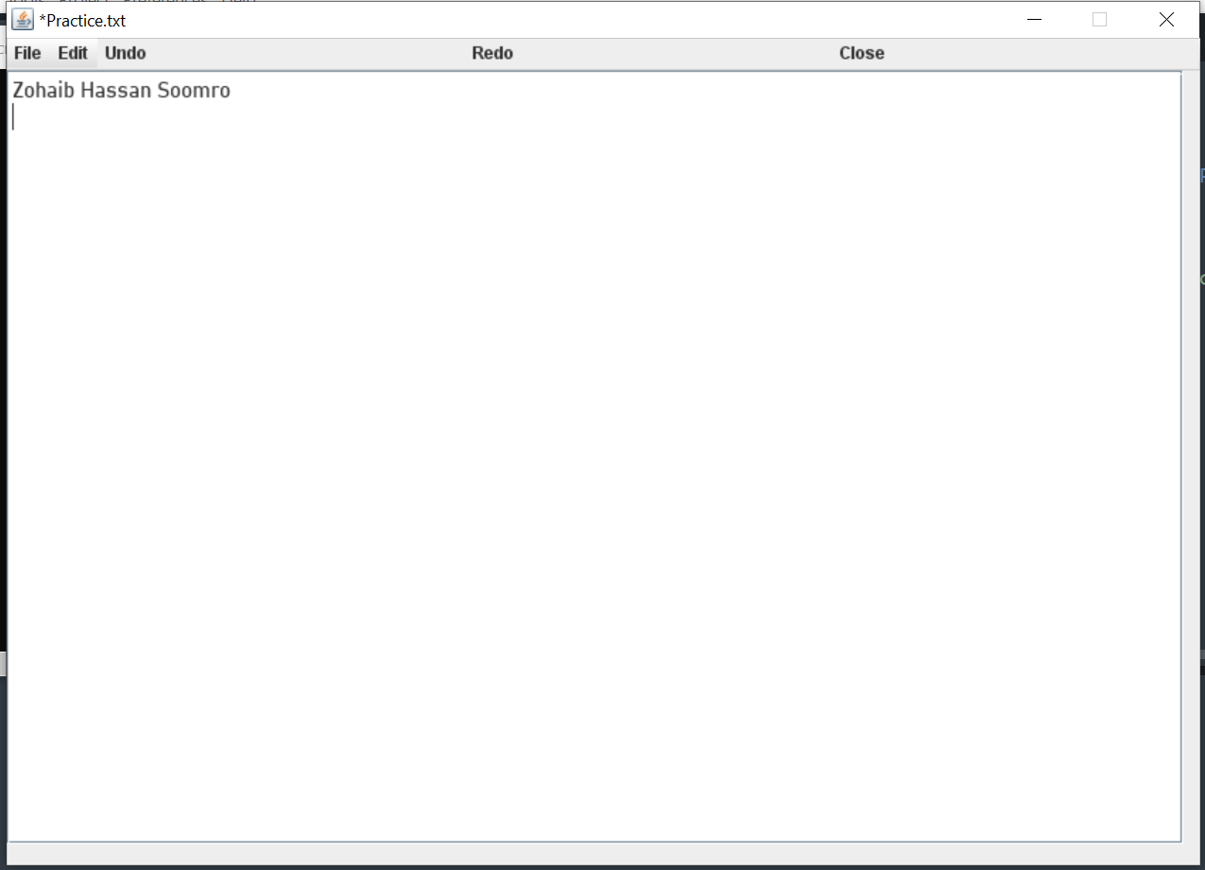
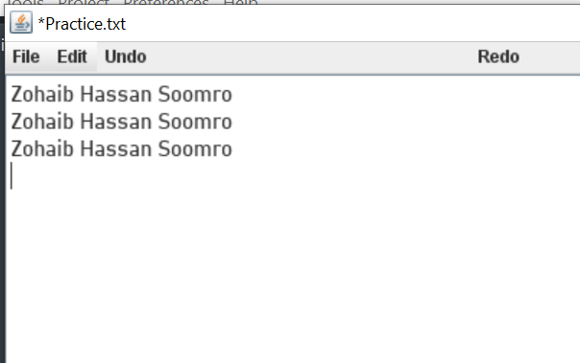
Redo

Slide 13
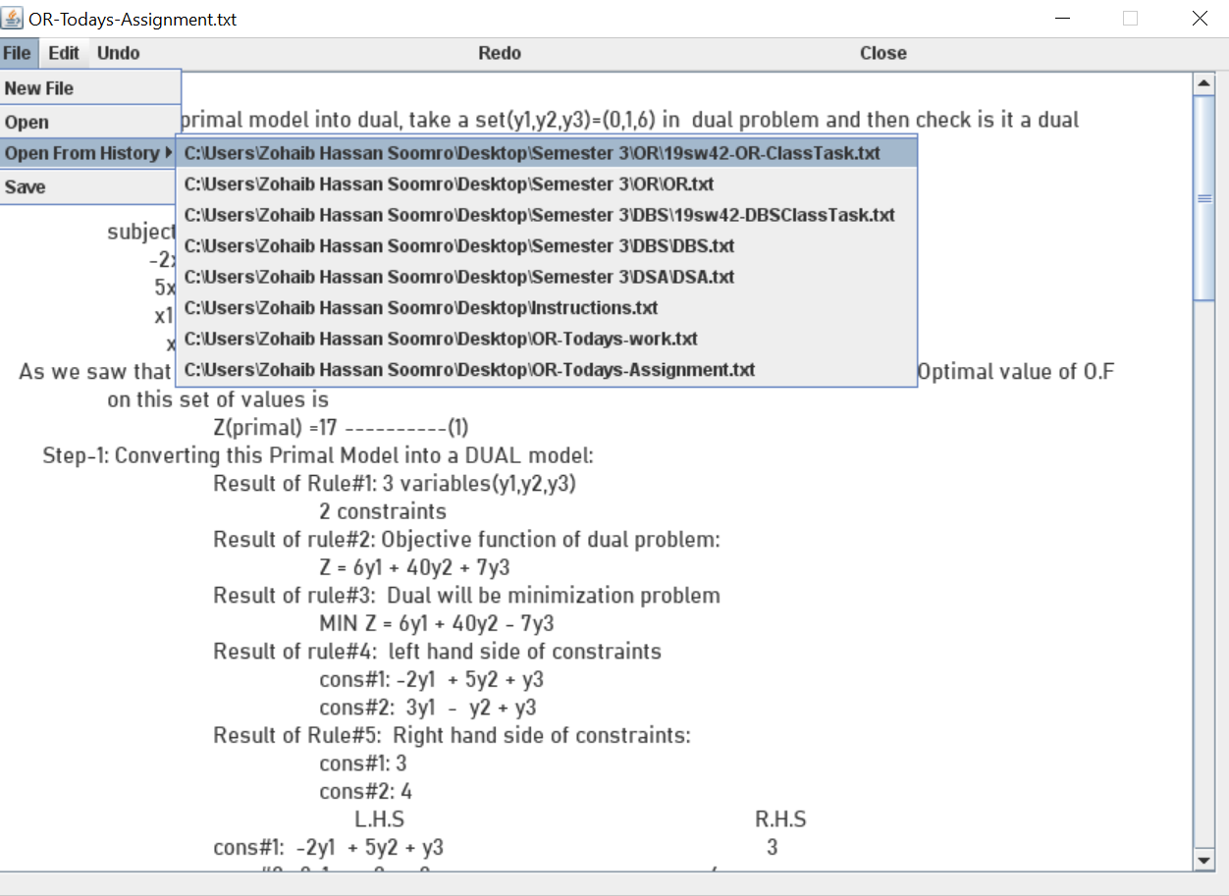
Open From History

Slide 14
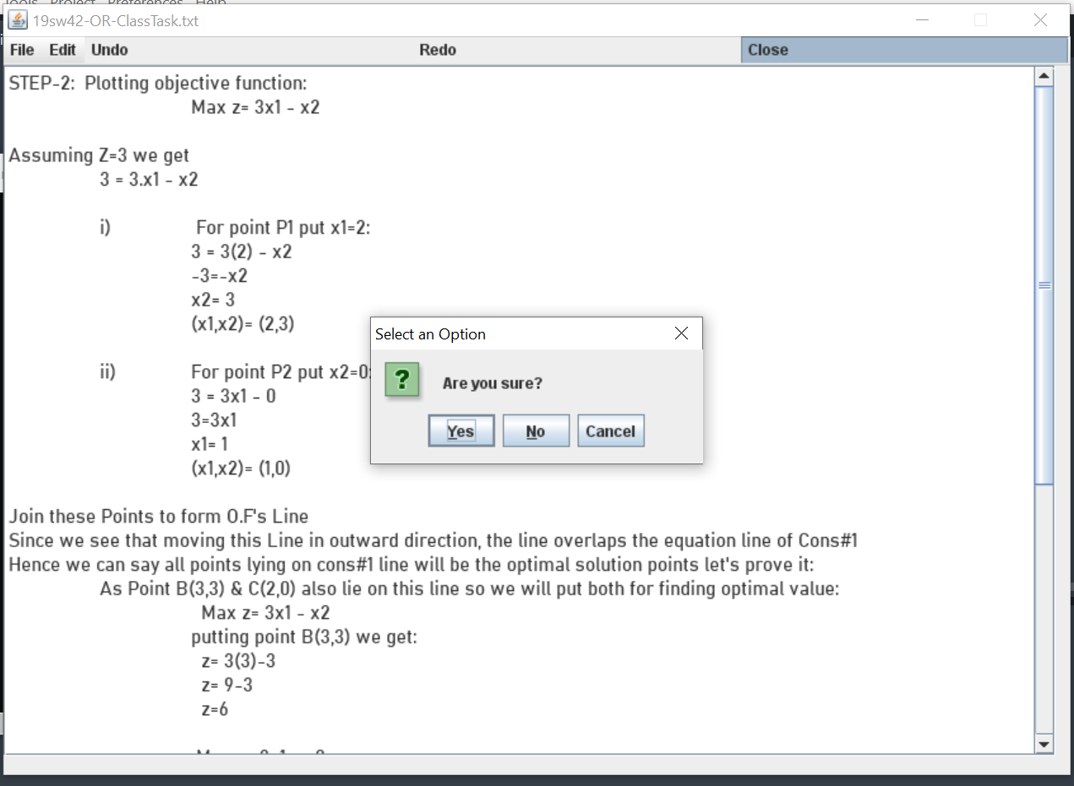
Close

Slide 15
Youtube Video link
https://youtu.be/iF4MLeCV3kY

Slide 16
(:☺ THANKS☺:)

